Slide 1




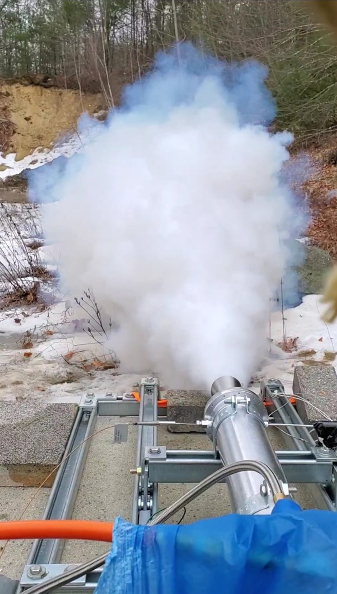
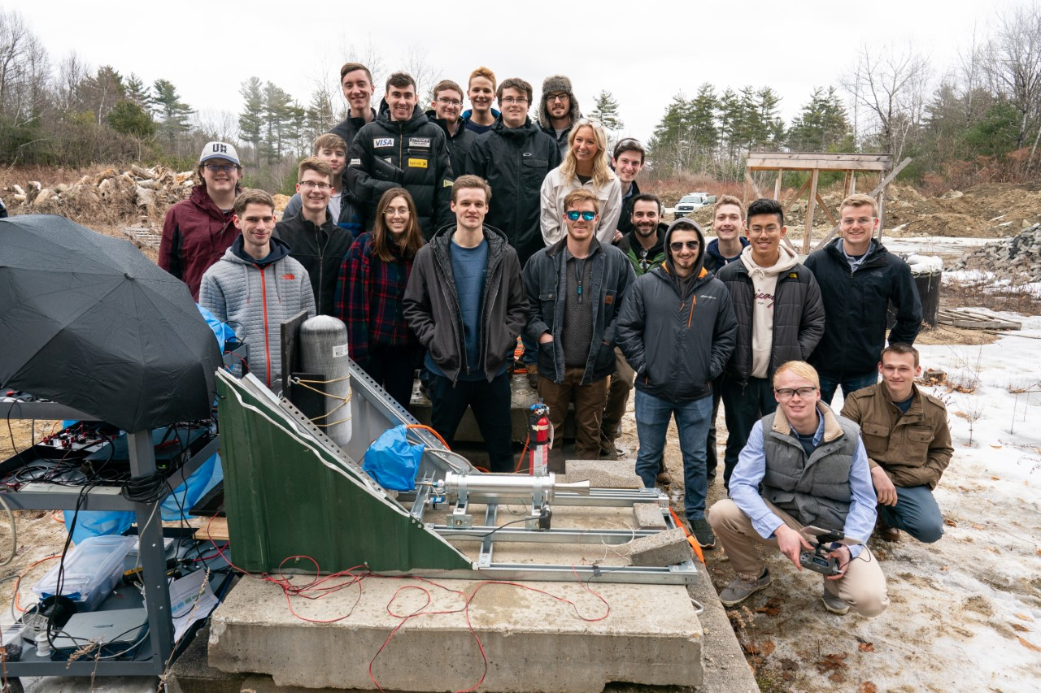
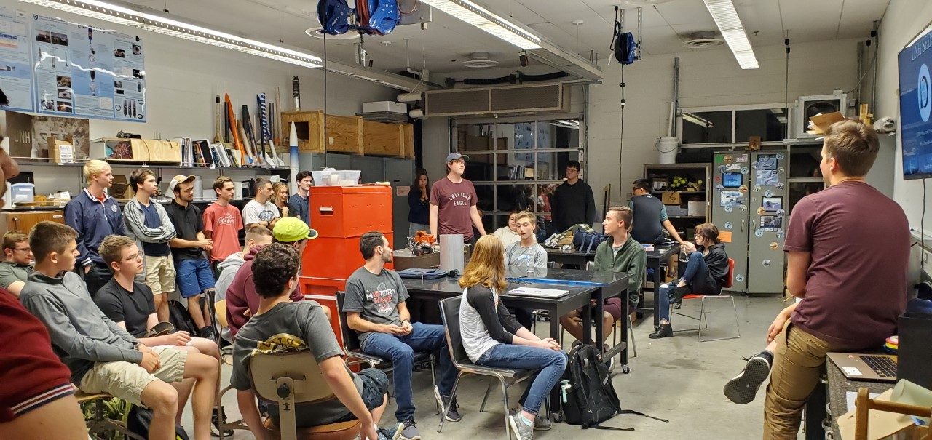
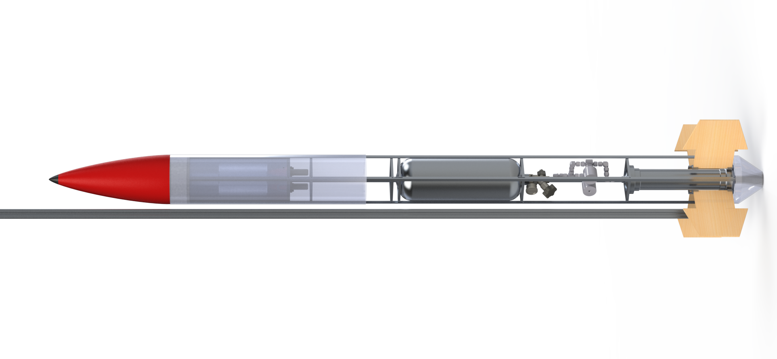
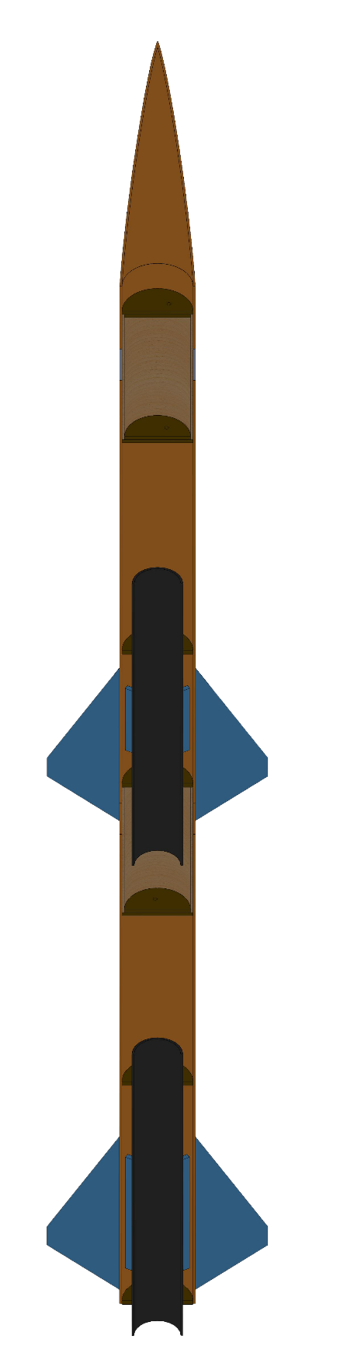
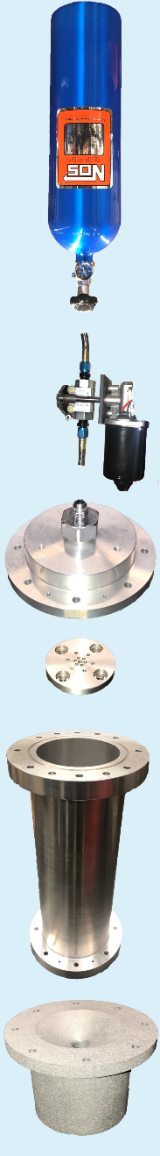


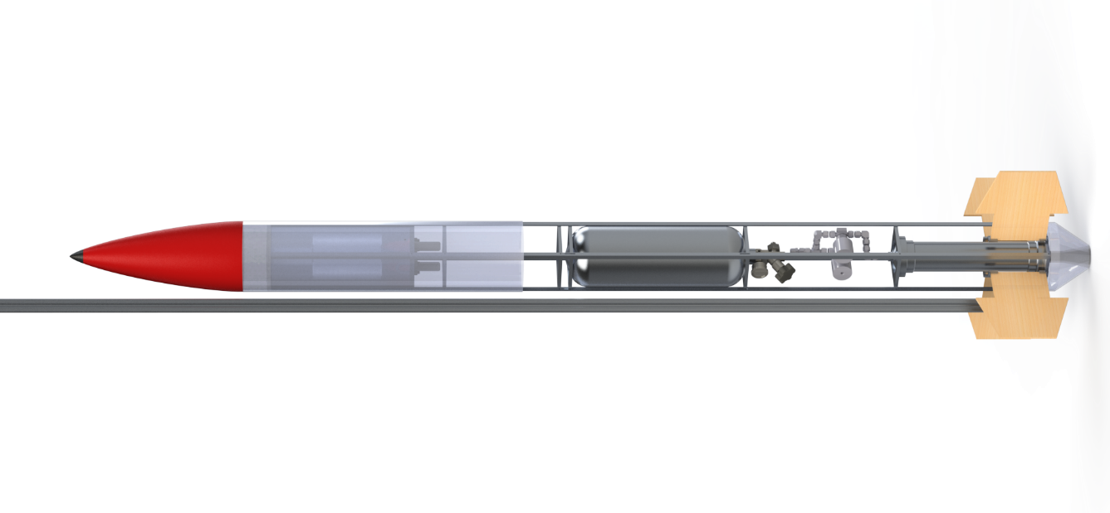
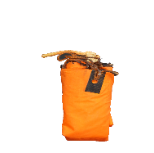
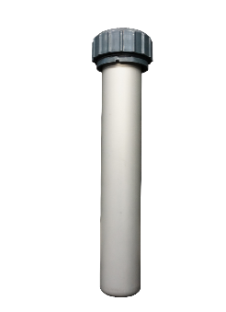
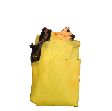

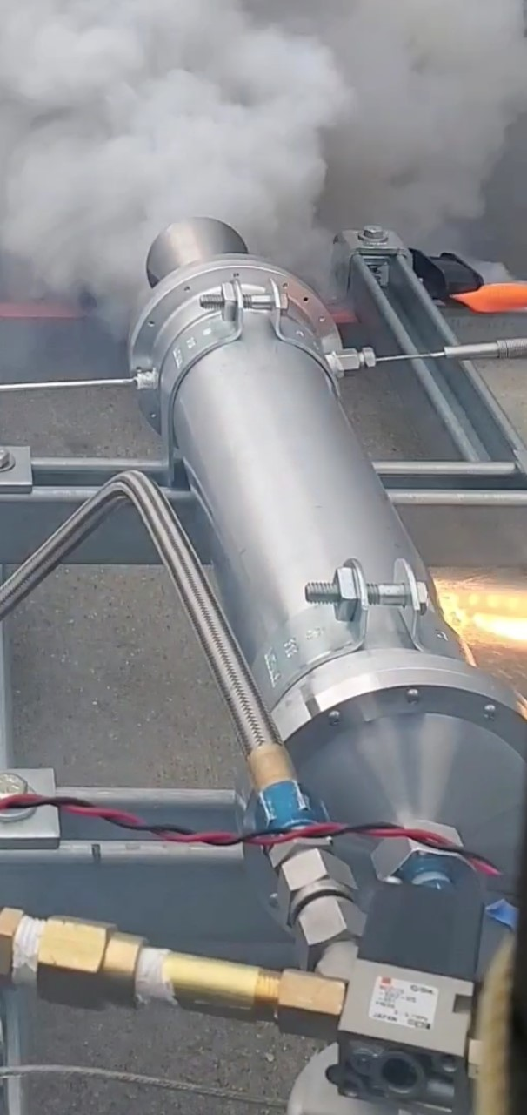
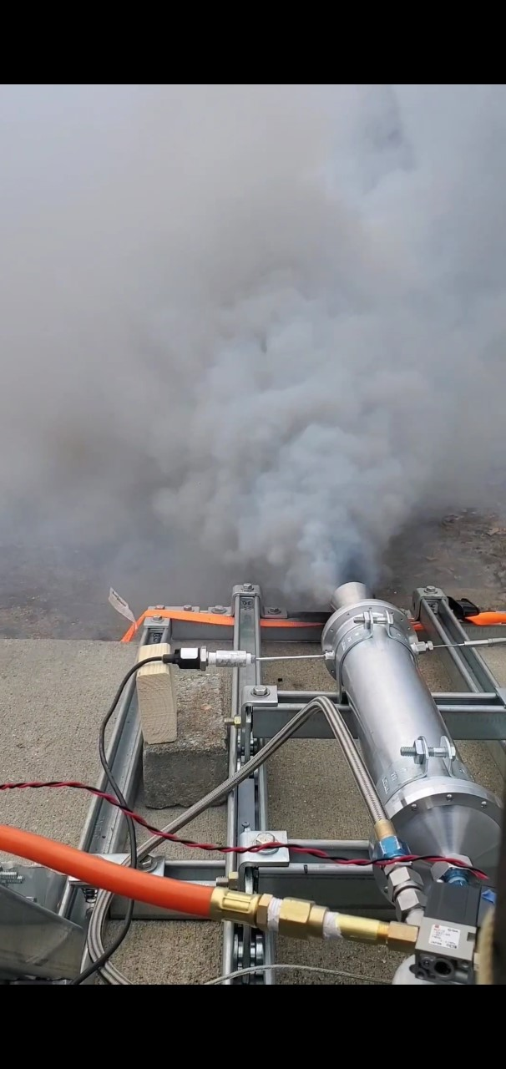
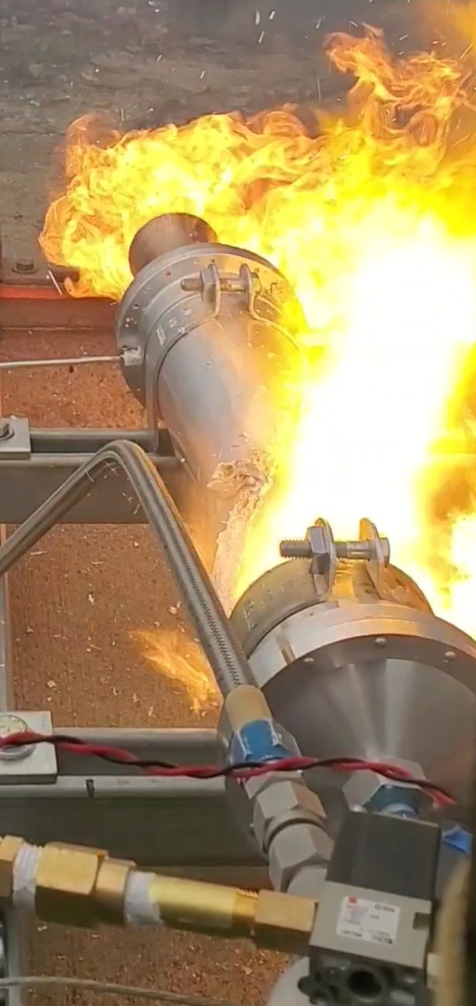
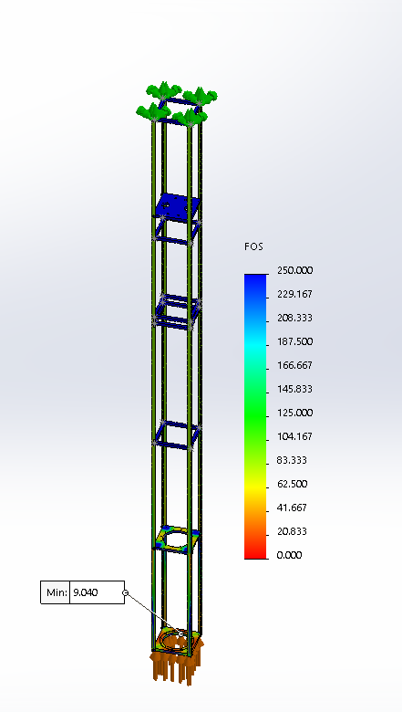
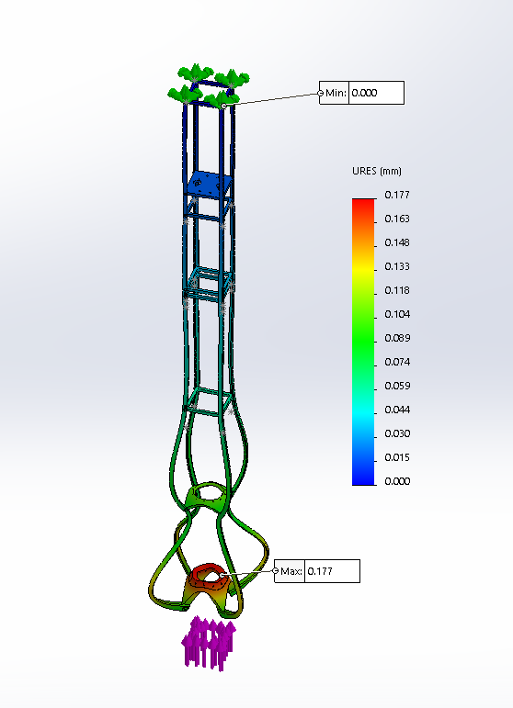
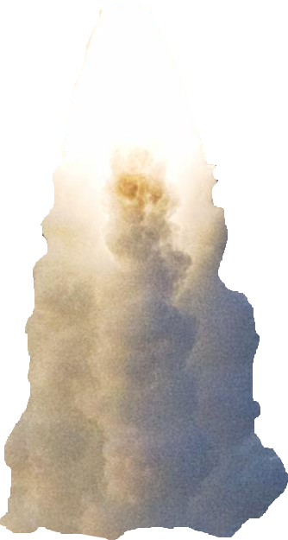
Department of Physics and Department of Mechanical Engineering
Author: Thomas Collins Advisor: Marc Lessard
Team Members: Charlie Nitschelm, Zachary Raboin, Silas Johnson, Lucas Simmonds, Carly Benik, Nathan Gunter, Darren Otten.
Who We Are
A third-year engineering organization comprised of students of all classes and CEPS majors
A primary engineering goal of pursuing the art of high-power rocketry with custom-made hybrid engines
Propulsion
On August 20th, 2019 UNH SEDS conducted its first of three hot fires for 2019-2020.
An unscheduled disassembly of the graphite nozzle led to inadequate data for analysis.
“V1”, utilized hydroxyl-terminated polybutadiene (HTPB) and liquid nitrous oxide.
Stainless steel was used in all further nozzle designs.
The initial use of graphite was due to its ablative properties.
On March 6th, 2020 UNH SEDS conducted its second hot fire.
“V2”, utilized Paraffin wax and liquid nitrous oxide.
Maximum thrust of 25 lbf was recorded.
Specific impulse is a measure of how effectively a rocket uses propellant as fuel. We achieved an I_{sp}=177.12 sec
Our engine lacked the temperature and pressure required for stable combustion.
Nose Cone
The nose cone was 3D printed to a tangent ogival curve responsible for directing the flow of air outside of the rocket.
Nose Cone Tip
Aluminum was machined to the tip of a tangent ogival curve with a surface finish of 32 Ra. Vital to minimizing drag at the most critical point on the rocket.
Recovery Bay
Responsible for the recovery of the rocket via dual stage deployment. Raptor CO2 cartridges are used as stored internal energy devices.
Hot fire Test, March 2020
SEDS General Meeting, Spring 2020
Electronics Bay
An enclosed volume where the electronics of the rocket are stored. A combination Raspberry pi’s, Arduino’s and an Altus Metrum Telemega are used.
The 3 Year Plan
Payload Bay
An enclosed volume where the payload is contained. This payload can be a measurement device or dead-weight.
Year One
Year Two
Year Three
Rocket Building
Simulating
Launching
Optimizing
Hybrid Engine
Design
Manufacture
Cold / Hot fire test
Hybrid Rocket
Engine Optimization
Rocket Integration
March 6th, 2020 hot fire test
Oxidizer Tank
A highly pressurized vessel that
contains liquid nitrous oxide,
acting as our oxidizer within
the combustion chamber
Flow Regulator
A solenoid valve that controls flow of the oxidizer into the injection plate. Flow regulation can also be used to vent the rocket fuel incase of an emergency.
Injection Plate
Responsible for providing desired oxidizer flow into the combustion chamber with the assistance of the impinging plate
Combustion Chamber
An enclosed volume where the solid reducer and liquid oxidizer react to produce a superheated, highly pressurized chamber of gas
Frame Design
Fins
Fins provide stability during flight, allowing the rocket to maintain its orientation in flight. Critical to the relationship between CP and CG.
Nozzle
Stainless steel nozzle was machined at Seneca Machining. This geometry is responsible for directing the flow of hot gases outside of the combustion chamber into the environment providing thrust.
Tapered Base
The tapered base helps to reduce the aerodynamic base drag on the aft portion of the rocket.
Moment of chamber breach
March 20th, 2020 hot fire test
Aluminum and Paraffin fire
On March 12th, 2020 UNH SEDS conducted its third hot fire.
“V2”, utilized Paraffin wax with 0.05% by weight Ferrocene Catalyst and liquid nitrous oxide.
Changes made since March 6th hot fire:
A reduction in nozzle throat diameter was made to increase chamber pressure.
An improved ignition system was used to increase chamber temperature prior to nitrous flow.
Maximum thrust of 45 lbf and an I_{sp}=318.522 sec was recorded.
Inconsistences in fuel grain led to a breach of the combustion chamber.
Current and Future Work
Re-design of the rocket body around a reduced diameter Oxidizer tank.
Optimum design of “V2” combustion chamber and nozzle.
Integrate thrust vectoring system onto the propulsion system
Further development into rocket payload, onboard or deployable instrumentation for Spaceport America Cup Competition.
Continuation of UNH SEDS within the CEPS community.
Factor of Safety: 200lbf applied to combustion chamber region of structure with fixed top.
Displacement: 200lbf applied to combustion chamber region of structure with fixed top.
The structural frame will act as the “house” for all the rocket's components. It will Incorporate, propulsion, avionics, and recovery. The design of our rocket frame is centered around cost, manufacturability, weight, strength, and availability. A minimum FOS of 9.04 and maximum displacement of 0.177 mm was seen for an applied force of 200 lbf.
Acknowledgments
A huge thanks to all the members of UNH SEDS, Scott Campbell, Ronald O’Keefe, Dr. Ivo Nedyalkov, Dr. Alireza Ebadi, Sheldon Parent, James Abare, Andy Globe, Dave Emanuel, Adam Smith, Chief Dean, TURBOCAM International, Reilly Webb, Ross Thyne, Seneca Machining, the UNH Makerspace and our Mechanical Engineering advisor Dr. Todd Gross for all the support.

Slide 2
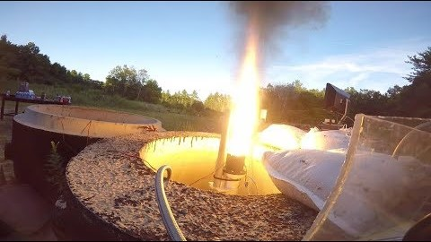

Slide 3
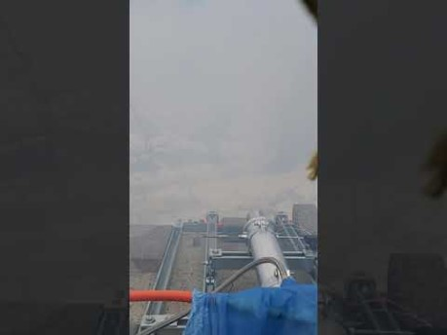

Slide 4
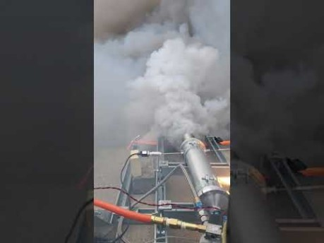

Slide 5


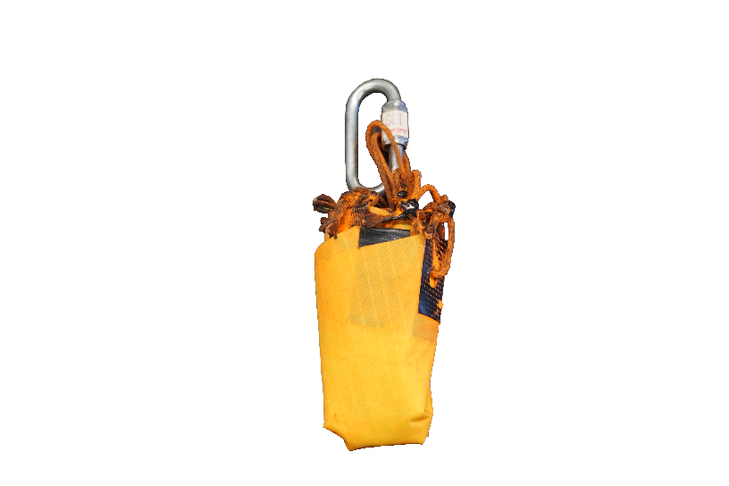
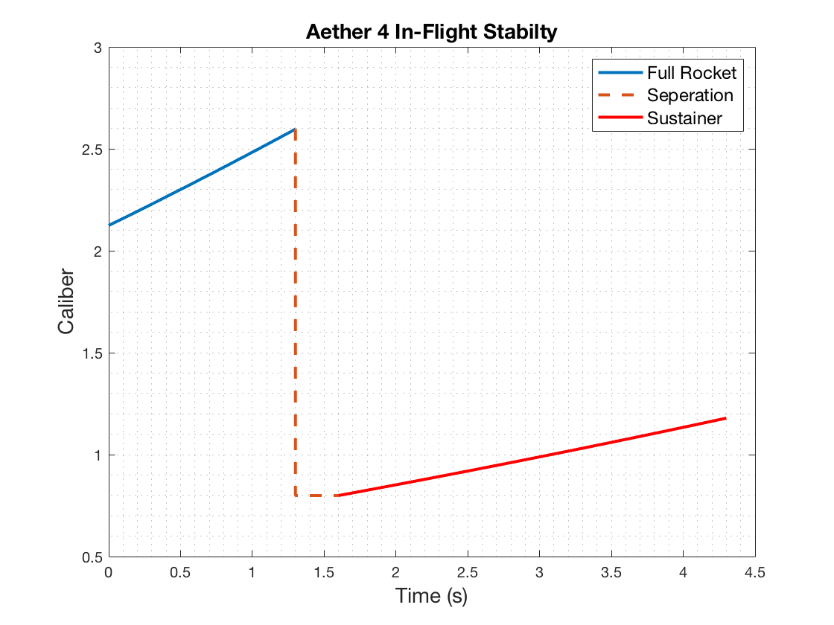
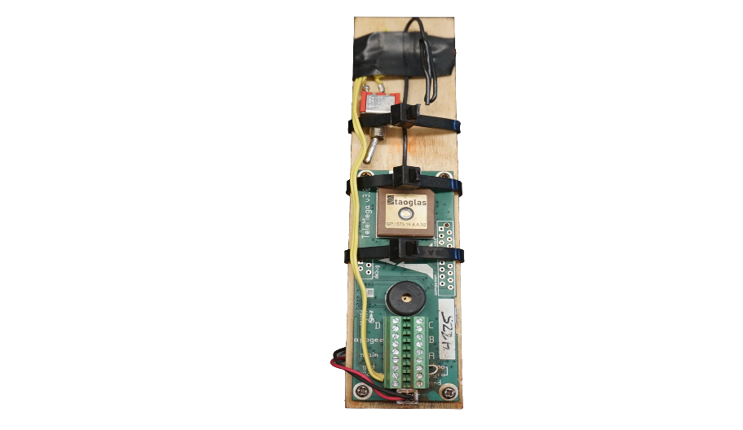
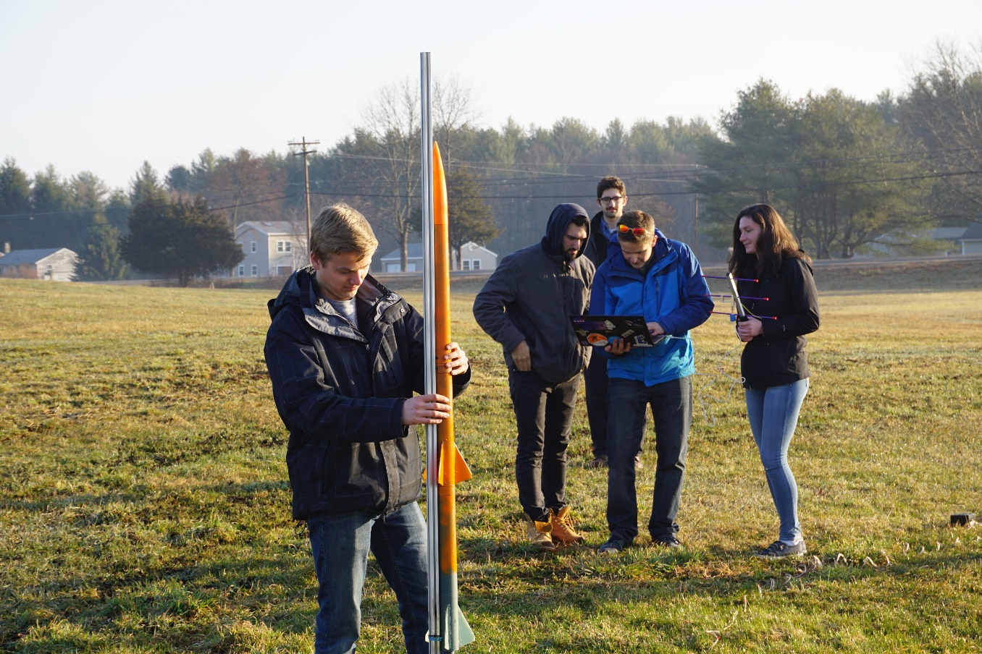
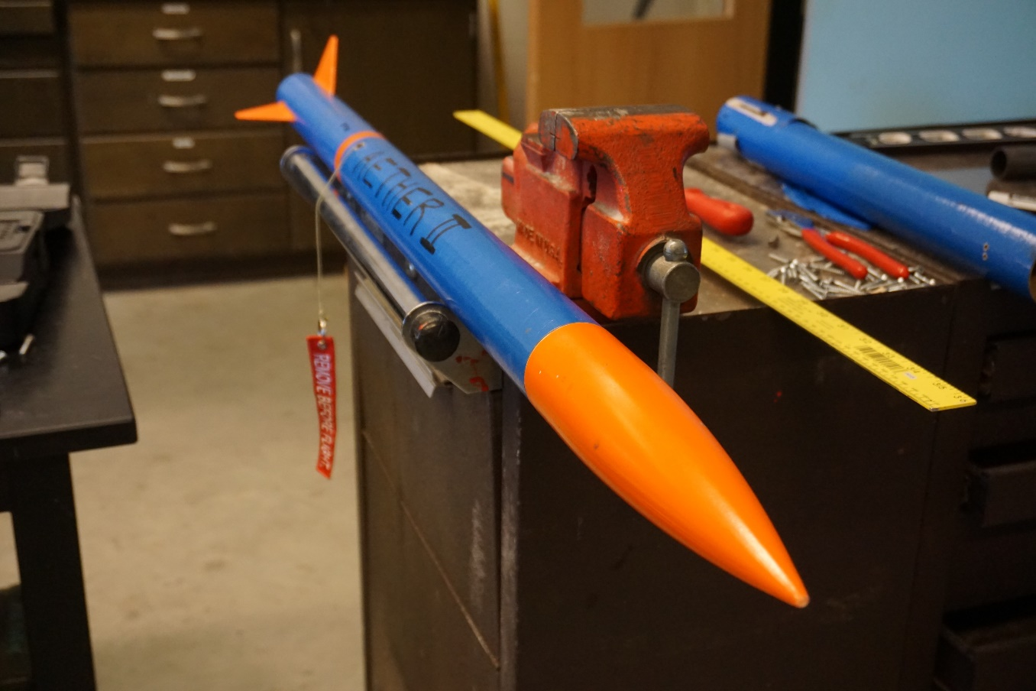
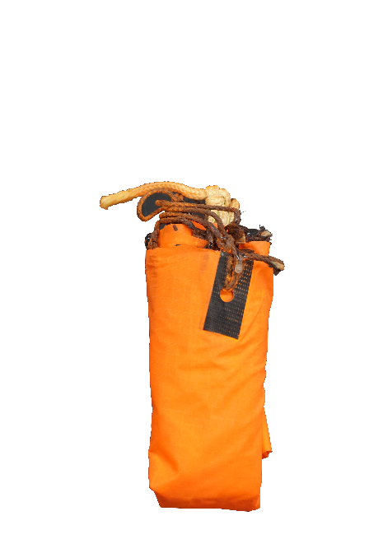

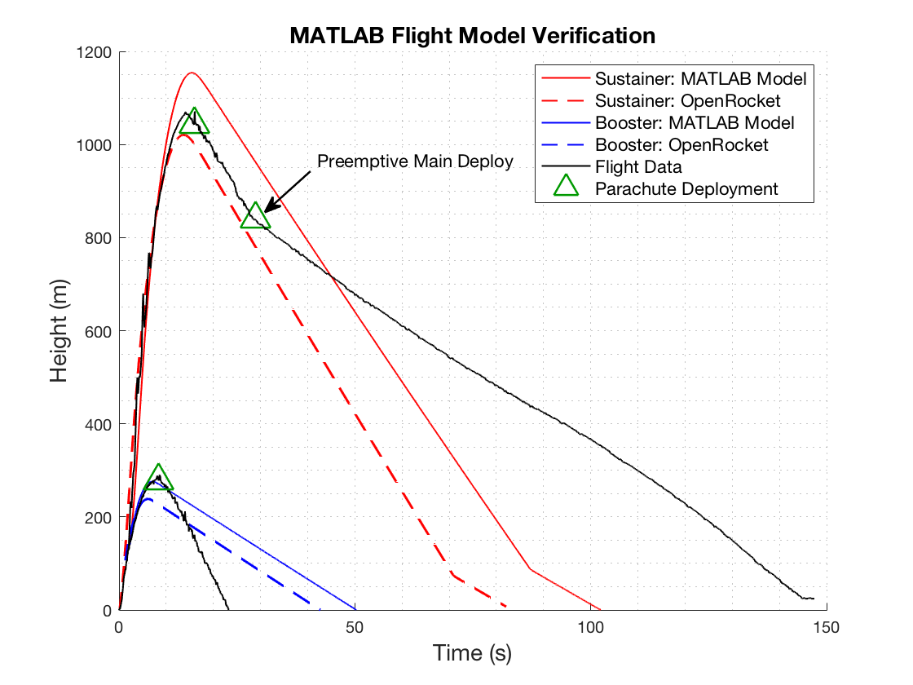
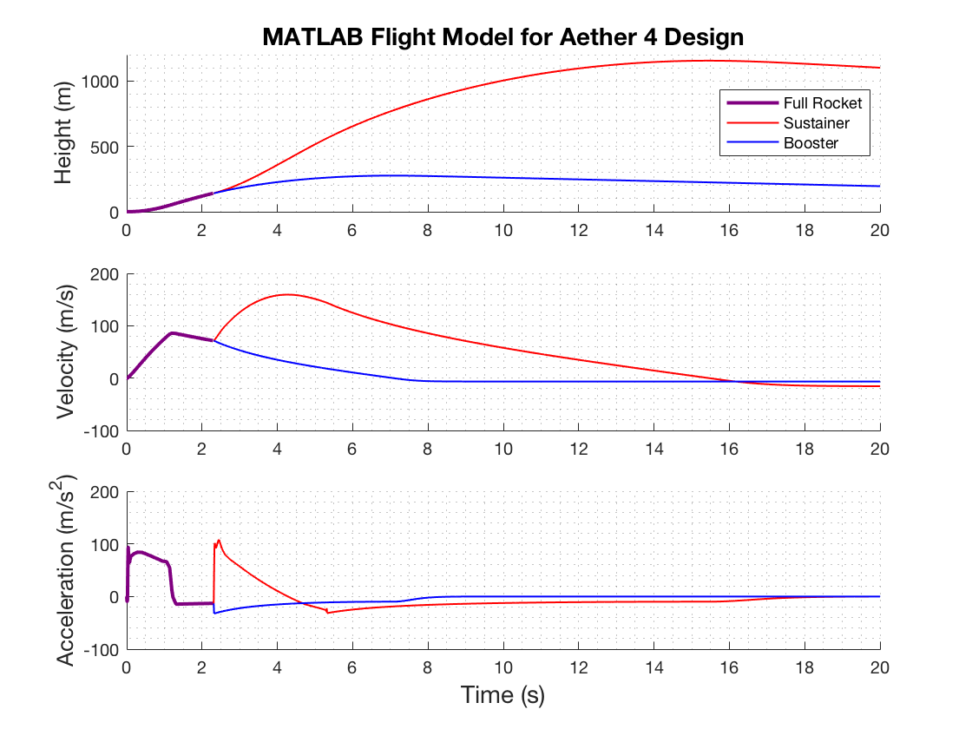


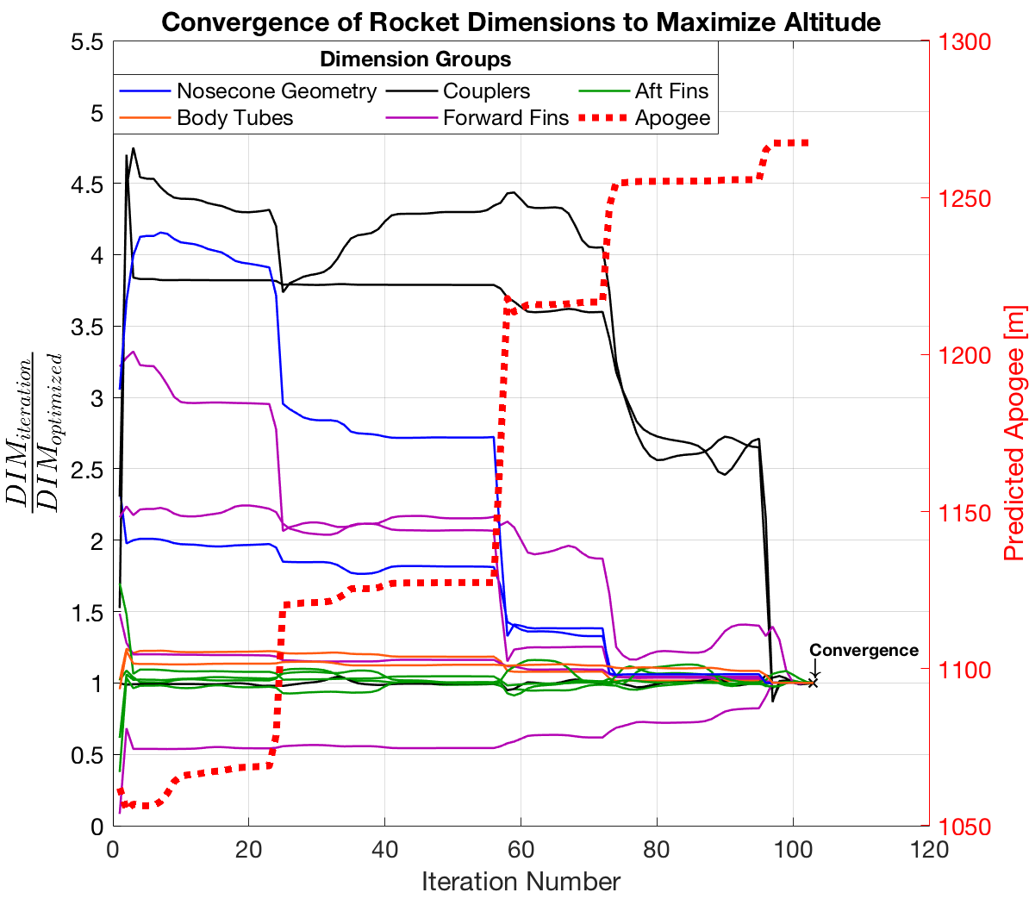
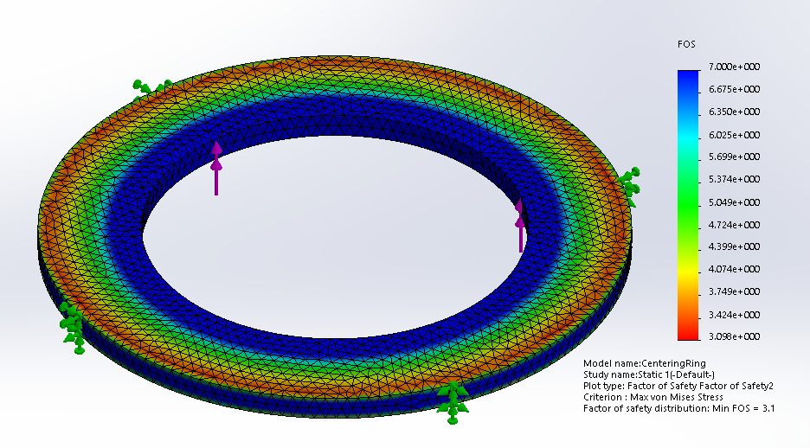
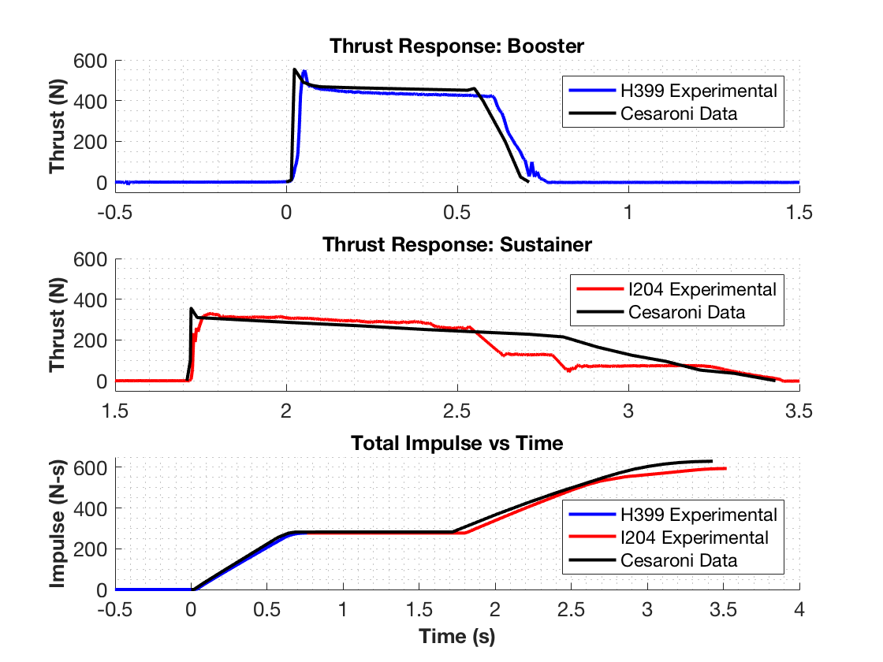
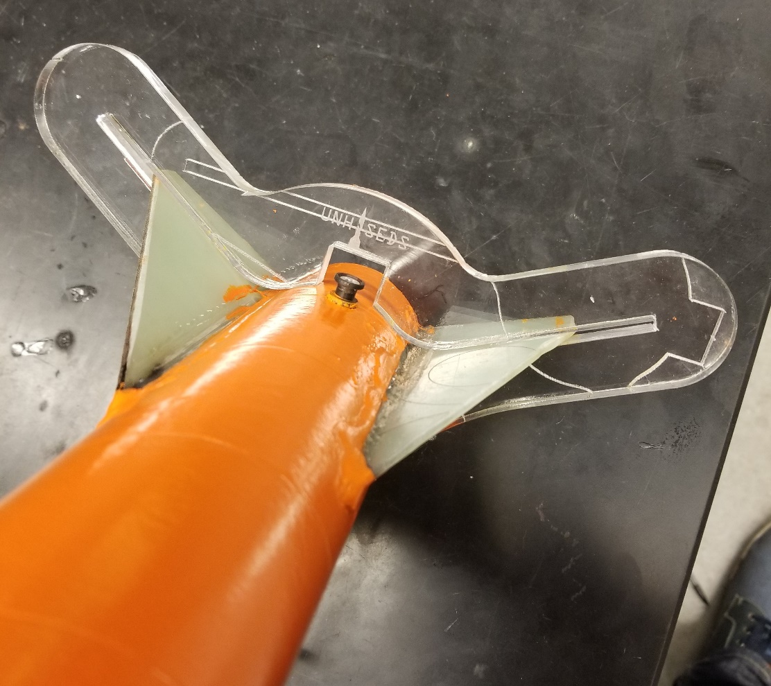
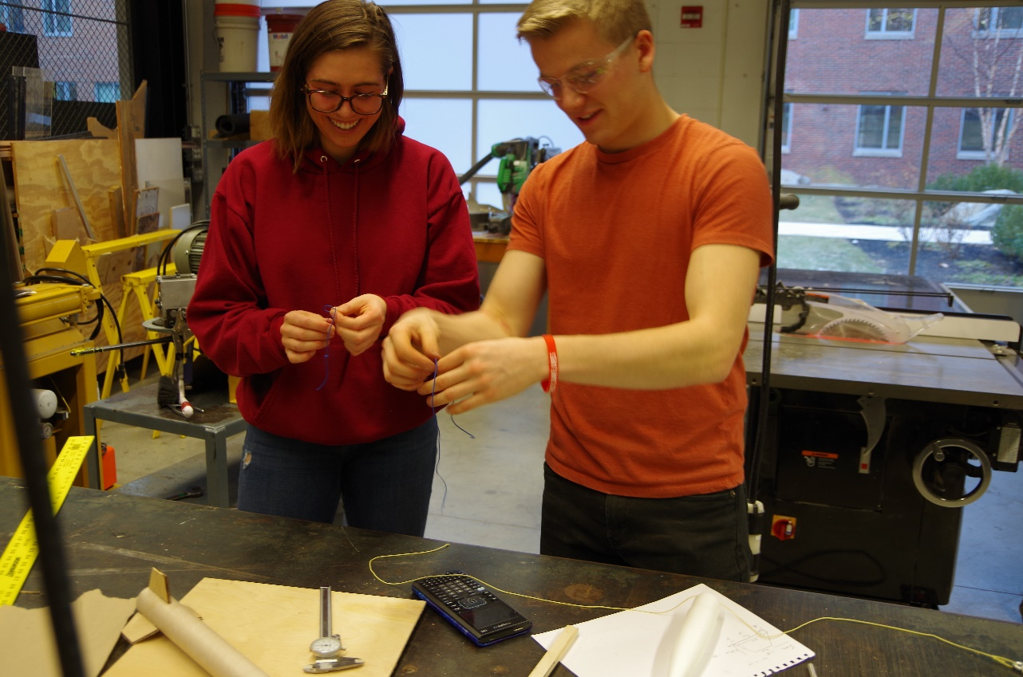
Department of Mechanical Engineering
Authors: Charlie Nitschelm, Kevin Bucher, Nick Clegg, Reilly Webb
Advisor: Dr. Todd Gross
Project Overview
To design, manufacture, and launch a high-powered, multi-stage rocket for the SEDS University Student Rocketry Competition
Goals
Design a high-powered engine class rocket to achieve maximum altitude
Implement a comprehensive recovery system that results in a fully reusable rocket
Constraints
Total combined engine impulse must not exceed 640.0 N-s
Must have at least two propulsion stages
Drogue Parachute
A small parachute deployed at sustainer apogee
Launch Simulation
Custom Nose Cone
A carbon fiber nose cone that houses the drogue parachute and connects directly to the electronics bay
Rocket trajectory was simulated using MATLAB. This required accurate stability, thrust, drag, and atmospheric models to produce ordinary differential equations that are then numerically solved for given rocket dimensions
Caliber is a measure of passive stability, and should remain between 1-3 for stable flight (right)
Electronics Bay
Houses the TeleMega GPS and controls both parachute deployment and sustainer ignition
Sustainer Parachute
A larger main parachute that
slows the sustainer to a safe landing speed
The MATLAB flight model is verified by comparing results to flight data from launches and to OpenRocket predictions (a pre-existing rocket simulation program)
 | Flight Data | OpenRocket Model | MATLAB Model
Sustainer Apogee | 1071.1 m | 1020.6 m | 1154.1 m
Booster Apogee | 290.0 m | 238.6 m | 276.3 m
Sustainer Engine
Propels the rocket to max altitude after booster burnout; 1.7 second burn time
Forward Fins
Provides stability to
the sustainer after stage separation
Check Integrity with Finite Element Analysis
Research Aerodynamic Theory
Optimize Rocket Dimensions
Staging Coupler
Supports stage separation at sustainer ignition
Manufacture and Assemble
Booster Parachute
A large parachute to slow the
booster to a safe landing speed
Improve
Aerodynamic Models
Rocket Improvement Cycle
Design & Analysis
An optimization program was created to determine the nominal dimensions for each component that will result in the highest simulated altitude.
An optimization program was created to determine the nominal dimensions for each component that will result in the highest simulated altitude
Launch and Gather Data
Booster Engine
Initiates flight with a
0.7 second burn time
Improve Manufacturing Techniques
Aft Fins
Provides stability to the rocket before stage separation
This was achieved by maximizing the height output from the combined aerodynamic models through nonlinear programming using the interior-point algorithm
Improve Field Launch Techniques
Propulsion
A Static Test Fire Rig was designed and manufactured to test the propulsion characteristics of each engine and to verify total engine impulse stays below 640.0 N-s
Optimization Constraints:
Maintain in-flight stability
Structural integrity factor of safety of at least 3.0
Manufacturing limitations
 | Reported Max Thrust | Measured Max Thrust | Reported Total Impulse | Measured Total Impulse
Booster Engine: Cesaroni H399 | 545.8 N | 549.6 N | 282.2 N-s | 277.1 N-s
Sustainer Engine: Cesaroni I204 | 356.8 N | 329.7 N | 347.7 N-s | 322.7 N-s
Manufacturing
Stress analyses are performed on the optimized components that are prone to failure, such as the engine centering ring (left)
A laser cut fin alignment tool was designed to keep fins in place during the epoxy curing process
Many components are assembled from scratch such as the nosecone, fins, ignition leads, ejection charges, and launch pad
Data acquisition was performed using the custom test rig, a 150 lb load cell, and NI SignalExpress software
Results were verified by comparing to official data reported by the engine manufacturer
Optimization must be reconfigured if resulting FOS is less than 3.0
Acknowledgments
A huge thanks to all the members of UNH SEDS, Prof. Martin Wosnik, Alireza Ebadi, Thomas Collins, the Parents Association, and our advisor Todd Gross for all the support

Slide 6
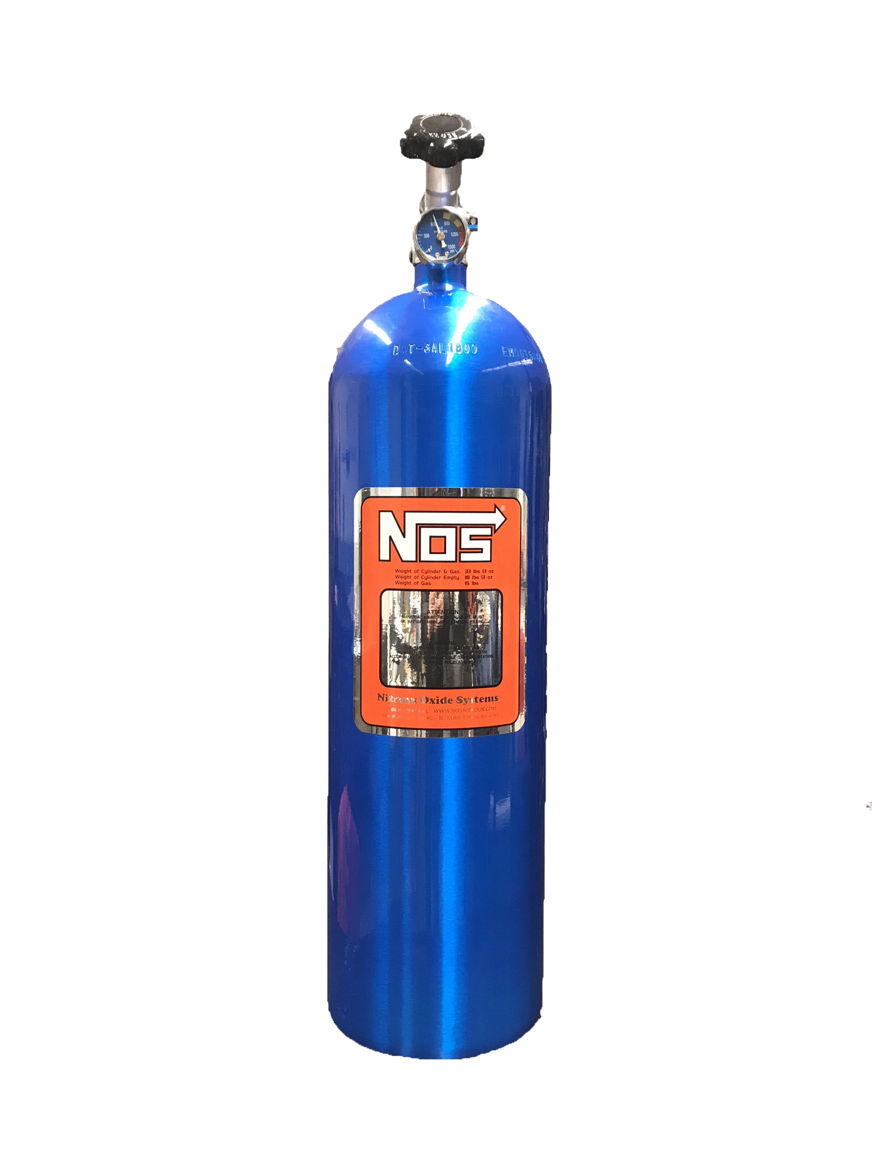
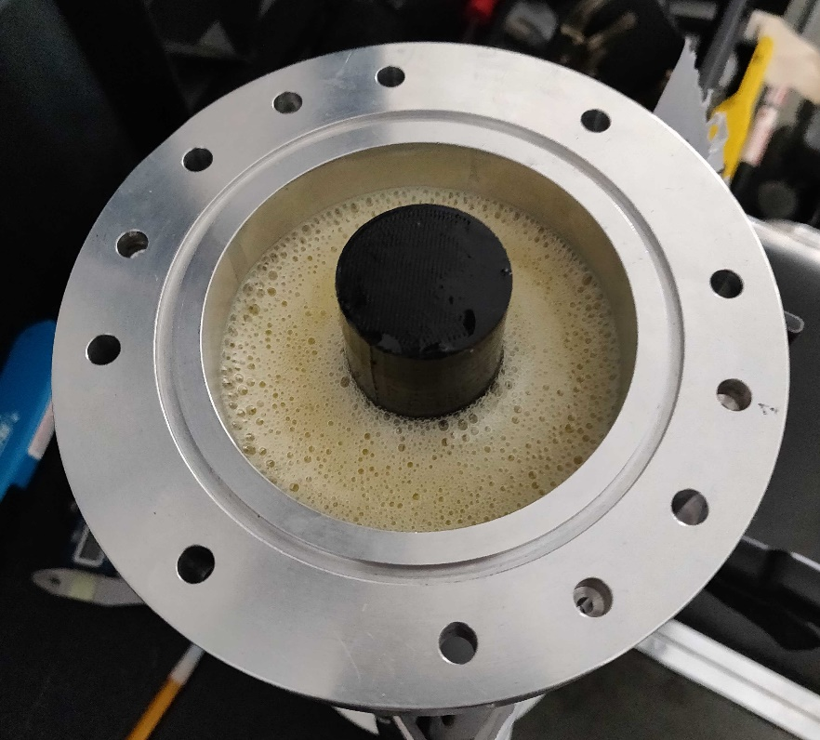
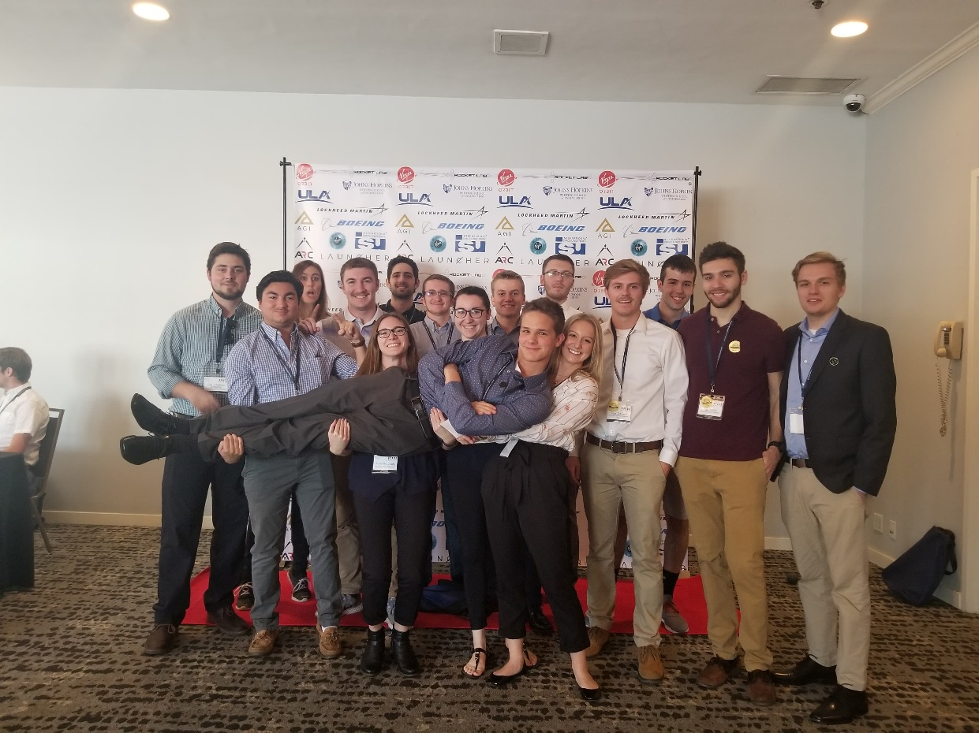
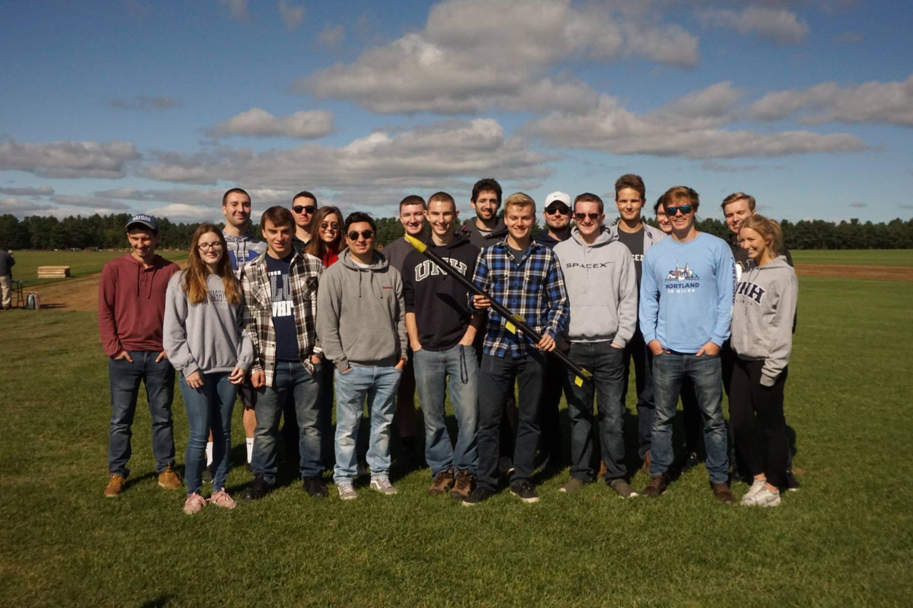
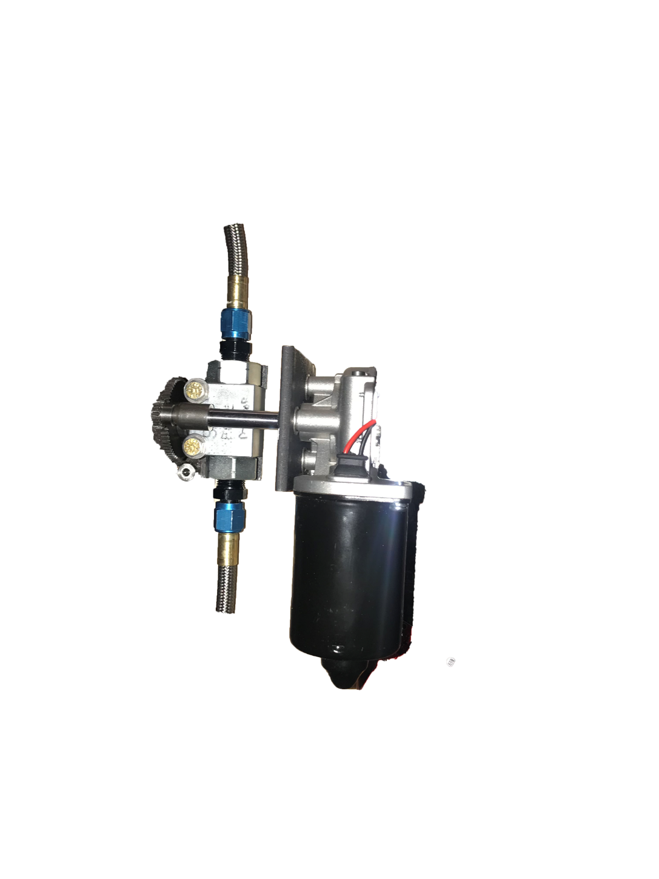
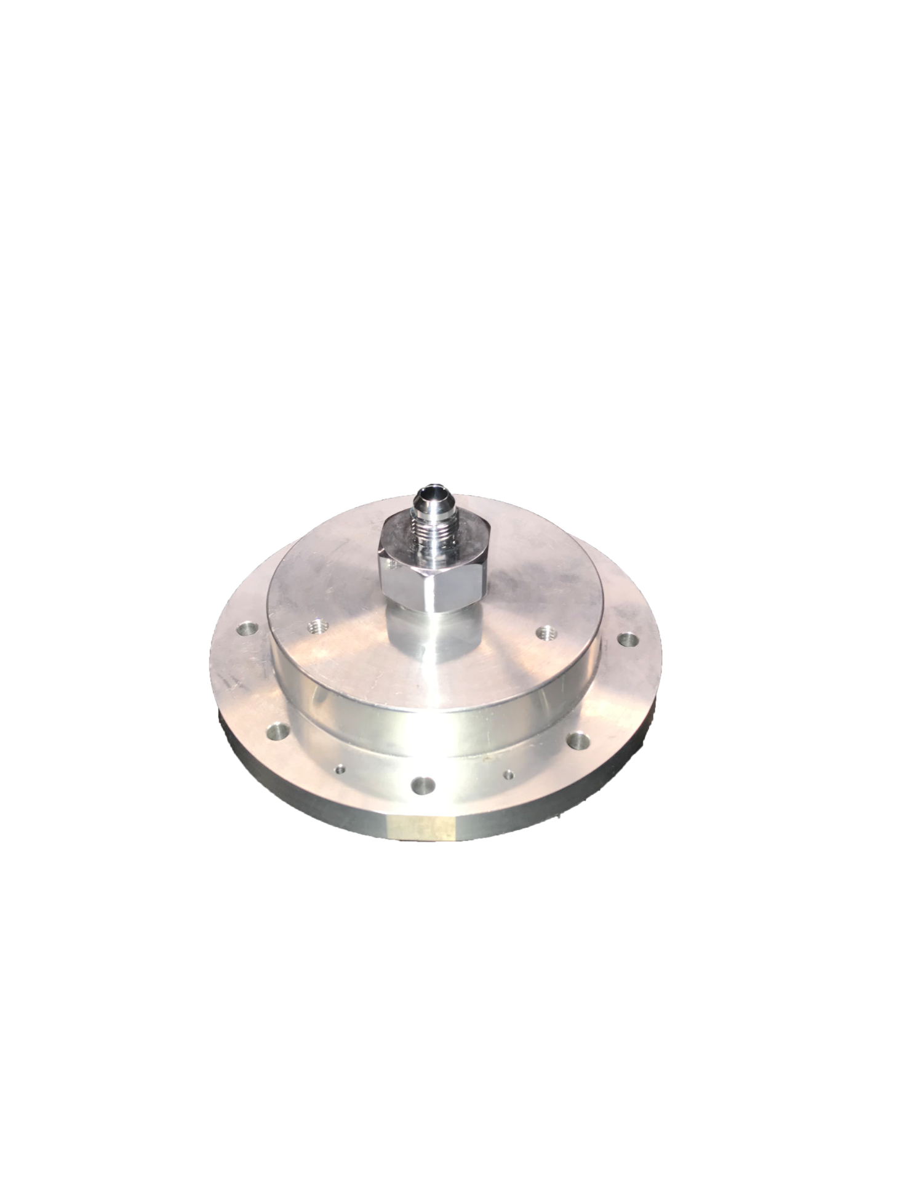
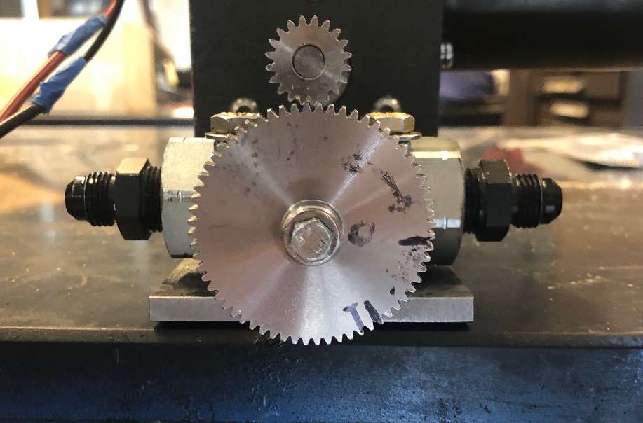
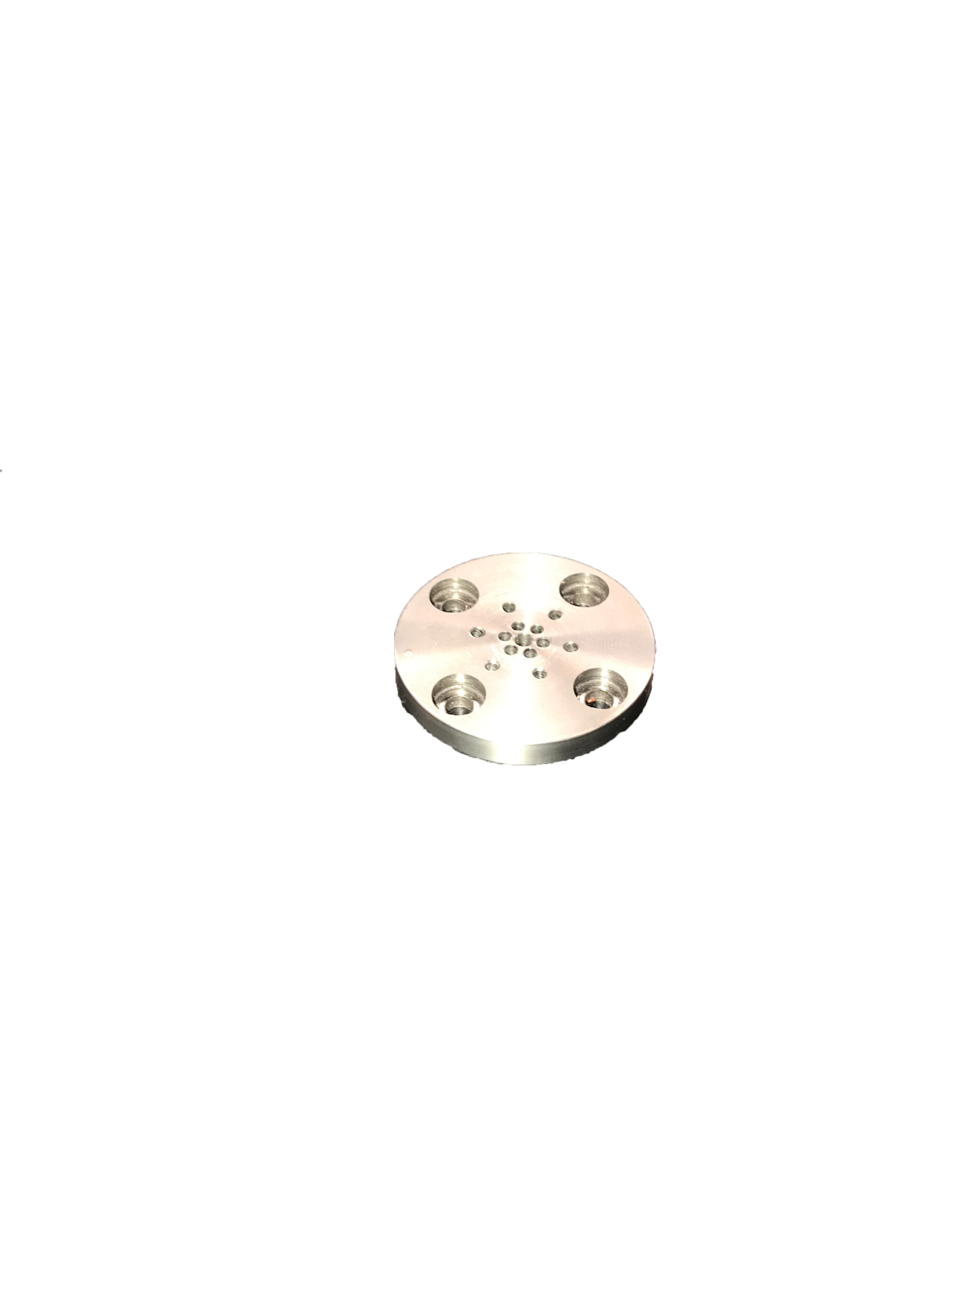
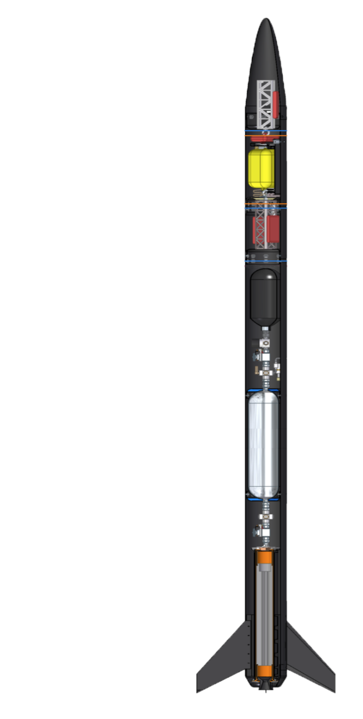
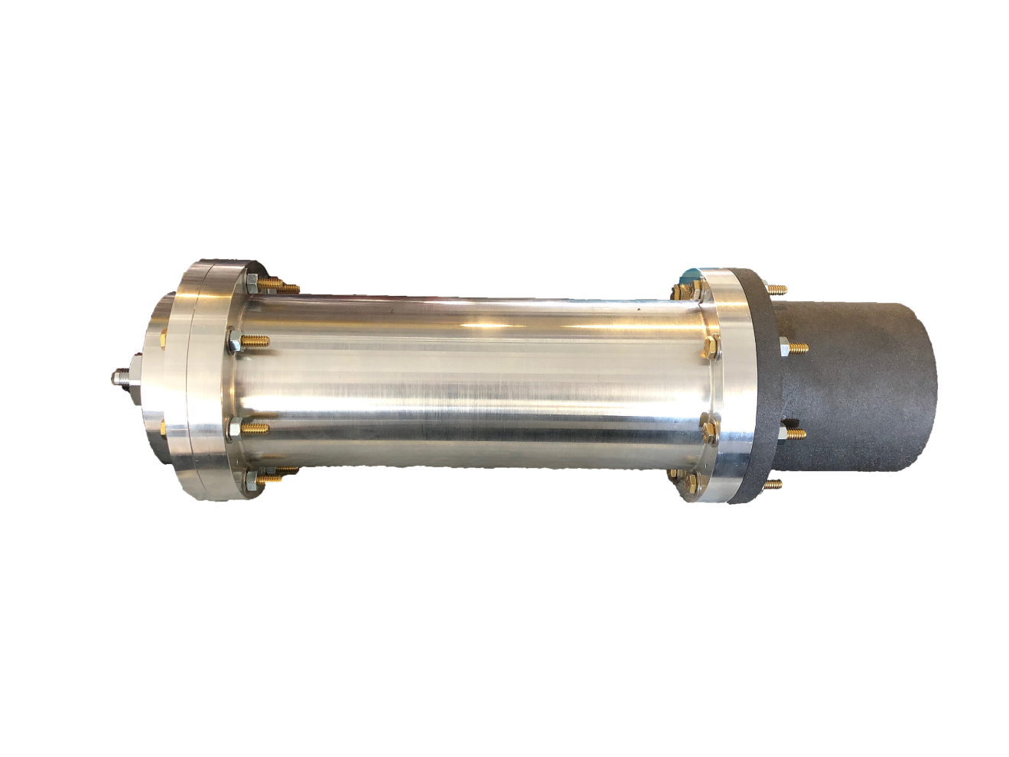
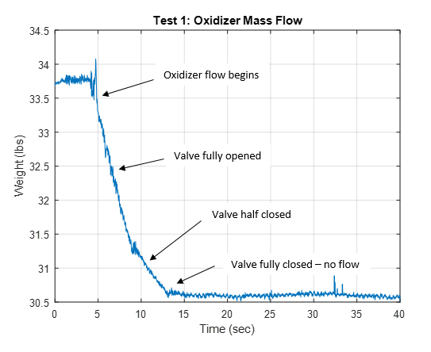
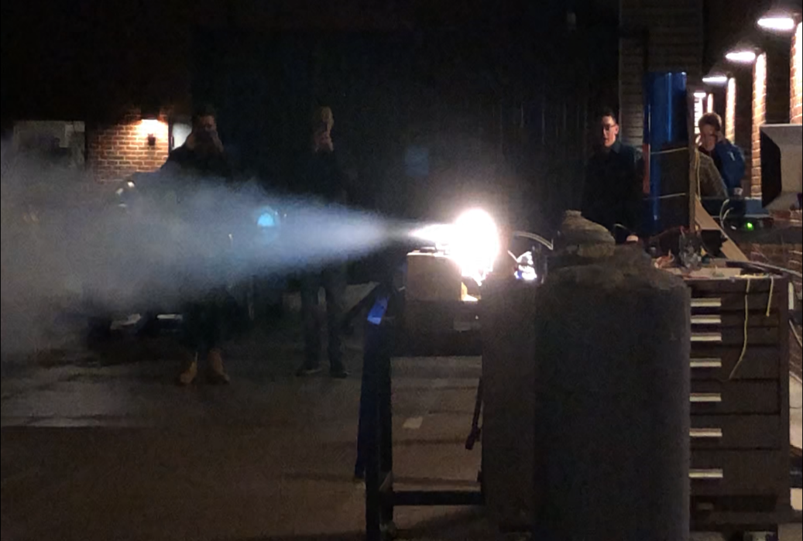
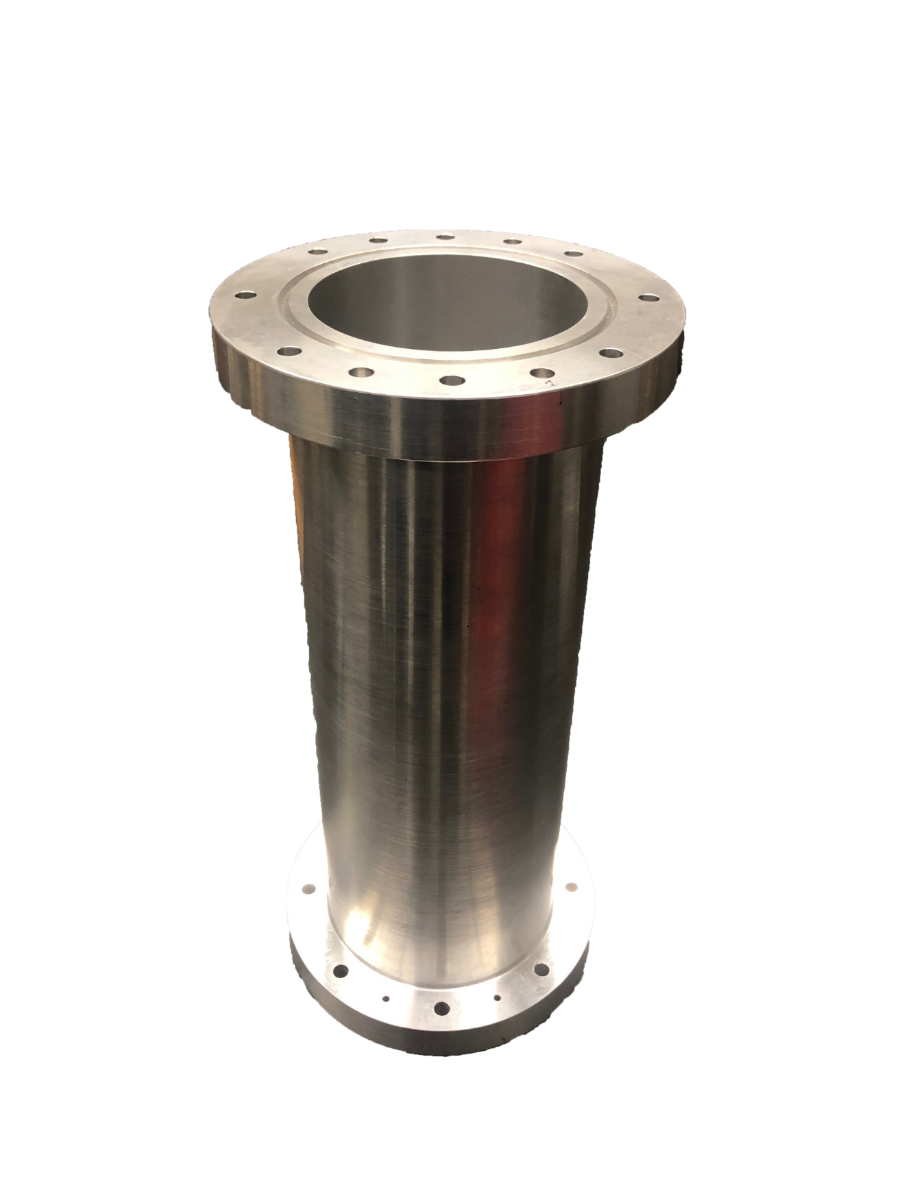
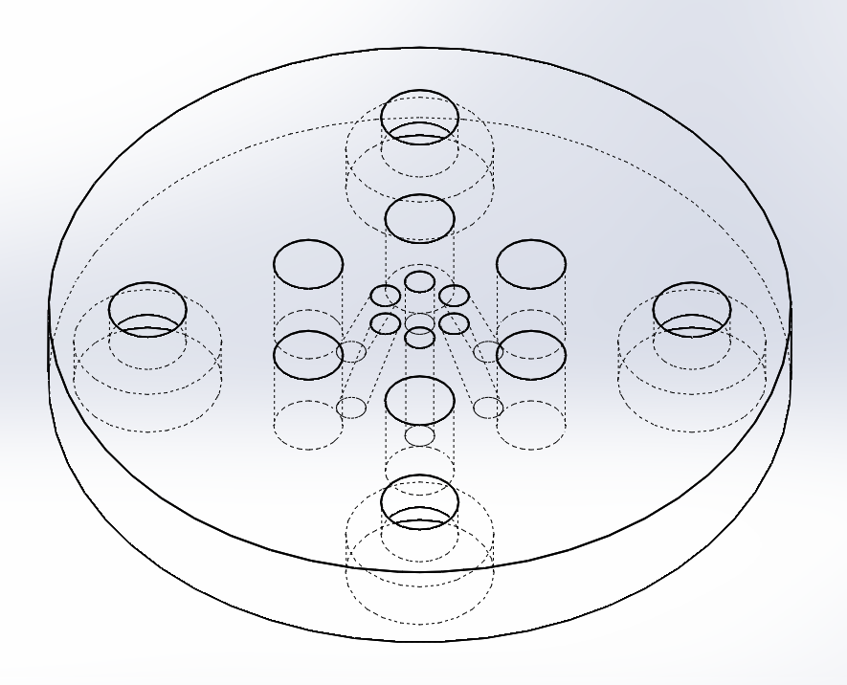
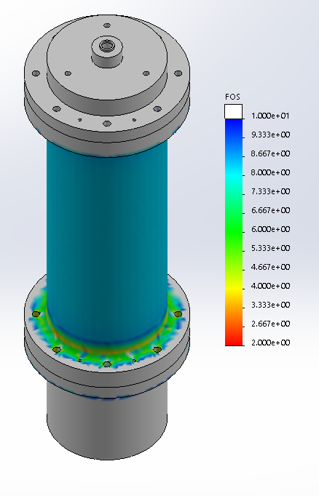
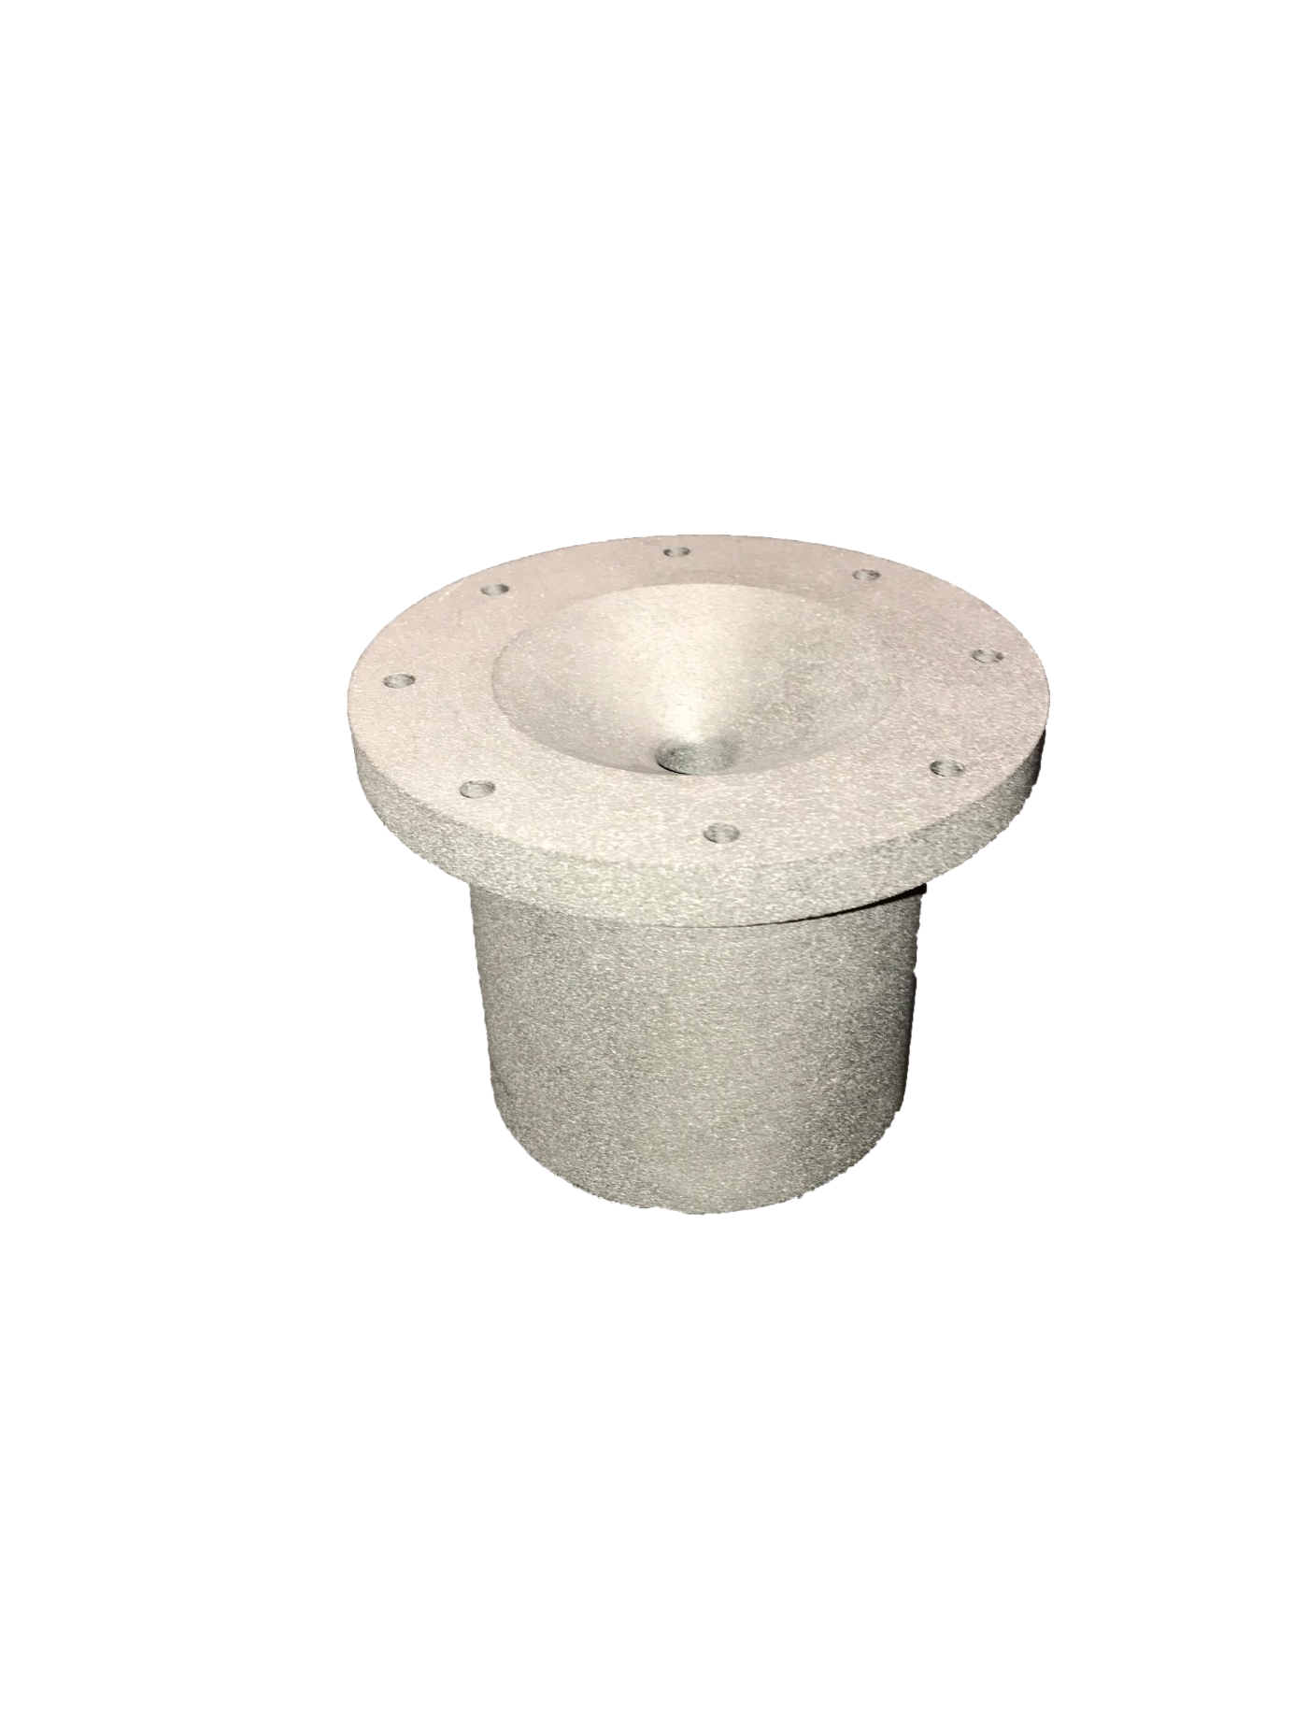
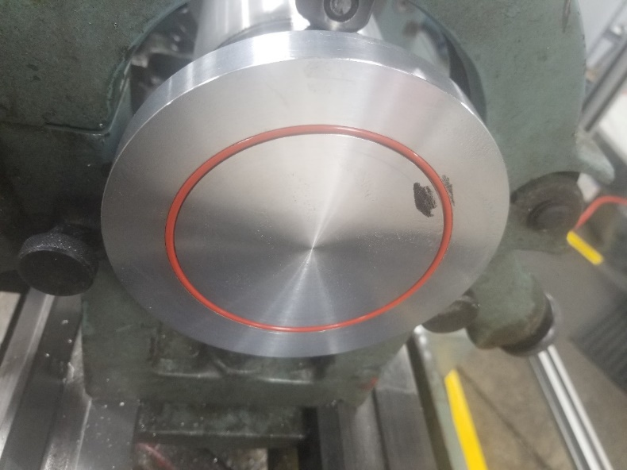
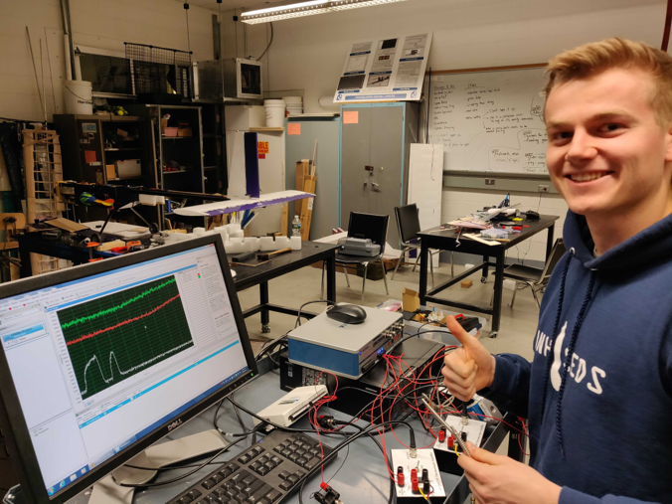











Department of Mechanical Engineering
Authors: Ryan Blatti, Thomas Collins, Chase Eldridge, Andrew Hosman
Silas Johnson, Tyler Landry, John Langer, Charlie Nitschelm, Collin Stroshine Advisor: Dr. Todd Gross
Who We Are
A second year engineering organization comprised of students of all classes and CEPS majors
A primary engineering goal of pursuing the art of high power rocketry with custom-made hybrid engines
Fuel Selection and Flow Regulation
Oxidizer Tank
A highly pressurized vessel that
contains liquid Nitrous Oxide,
acting as our oxidizer within
the combustion chamber
Hydroxyl-terminated polybutadiene (HTPB) and liquid nitrous oxide were chosen as the reducer and oxidizer, respectively.
A mold was 3-D printed to form the HTPB into a circular grain.
Flow Regulator
A motorized valve that monitors flow regulation
of the oxidizer into the injection plate controlled
by an electric motor and
an Arduino.
The flow regulator controls the amount of flow into the combustion chamber, permitting throttle, cutoff, and reignition
SpaceVision, November 2018
SEDS Rocketry Competition, October 2018
The 3 Year Plan
Injection Plate
Responsible for providing desired oxidizer flow into the combustion chamber with the assistance of the impinging plate
Oxidizer Injection
Year One
Year Three
Various impinging plates were designed to be tested for ideal atomization of the nitrous oxide for maximum efficiency within the combustion chamber
Hybrid Engine
Design
Manufacture
Test
A cold fire test was designed to study overall oxidizer flow characteristics and allow a desired oxidizer flow rate of 1.5 lb/sec to obtain an engine burn time of 10 seconds
Impinging Plate
An interchangeable cylindrical plate responsible for the impingement and atomization of the oxidizer flow streams
Runaway
Rocket Building
Simulating
Launching
Optimizing
Hybrid Rocket
Engine Optimization
Rocket Integration
Competition
Combustion Chamber
An enclosed volume where the solid reducer and liquid oxidizer react to produce a superheated, highly pressurized chamber of gas
Year Two
Combustion and Ignition
Hot Fire Test
Incoming nitrous oxide impinges and atomizes saturating the fuel within the combustion chamber producing vast amounts of hot, dense gases.
A river of hot gases flow through the graphite De Laval nozzle, converting its thermal energy into kinetic energy.
Worked with the UNH police and fire departments to locate a safe testing range and procedures.
Test engine to determine thrust, mass flow rate, combustion temperature and overall functionality.
Load cells and thermocouples were used to record data required for future optimization.
Designed and manufactured a static test fire rig to secure the engine and withstand a force up to 500 lbs of thrust.
Three hot fire tests were attempted, but due to weather, failed ignition and flow regulation a successful test has yet to be completed.
Nozzle
Graphite was machined into a de Laval curve responsible for directing the flow of hot gases outside of the combustion chamber into the environment providing thrust
An igniter device is utilized to produce hot gases within the combustion chamber in preparation for oxidizer flow through the impinging plate.
Thrust Vectoring
Current Work
4 steel pins are used to allow rotation of the hybrid engine while maintaining even distribution of thrust to the entire rocket
Improve flow regulation design by reworking gears
Successfully test hybrid engine and work towards an optimum design using STFR V2
Integrate thrust vectoring system onto the propulsion system
Create accurate launch simulations with real-life data from the hybrid engine and rocket geometry
A gimbal ring is used to provide a second rotational piece that is placed between the engine and the rocket body
Acknowledgments
A huge thanks to all the members of UNH SEDS, Scott Campbell, Dr. Ivo Nedyalkov, Dr. Alireza Ebadi, Sheldon Parent, Andy Globe, Dave Emanuel, Chief Dean, Ronald O’Keefe, TURBOCAM International, Reilly Webb, the UNH Makerspace and our advisor Dr. Todd Gross for all the support
Two actuators positioned 90 degrees apart enable real-time pitch and roll control

Slide 7
Department of Physics and Department of Mechanical Engineering
Author: Thomas Collins Advisor: Marc Lessard
Team Members: Charlie Nitschelm, Zachary Raboin, Silas Johnson, Lucas Simmonds, Carly Benik, Nathan Gunter, Darren Otten.
Who We Are
A third-year engineering organization comprised of students of all classes and CEPS majors
A primary engineering goal of pursuing the art of high-power rocketry with custom-made hybrid engines
Propulsion
On August 20th, 2019 UNH SEDS conducted its first of three hot fires for 2019-2020.
An unscheduled disassembly of the graphite nozzle led to inadequate data for analysis.
“V1”, utilized hydroxyl-terminated polybutadiene (HTPB) and liquid nitrous oxide.
Stainless steel was used in all further nozzle designs.
The initial use of graphite was due to its ablative properties.
On March 6th, 2020 UNH SEDS conducted its second hot fire.
“V2”, utilized Paraffin wax and liquid nitrous oxide.
Maximum thrust of 25 lbf was recorded.
Specific impulse is a measure of how effectively a rocket uses propellant as fuel. We achieved an I_{sp}=177.12 sec
Our engine lacked the temperature and pressure required for stable combustion.
Nose Cone
The nose cone was 3D printed to a tangent ogival curve responsible for directing the flow of air outside of the rocket.
Nose Cone Tip
Aluminum was machined to the tip of a tangent ogival curve with a surface finish of 32 Ra. Vital to minimizing drag at the most critical point on the rocket.
Recovery Bay
Responsible for the recovery of the rocket via dual stage deployment. Raptor CO2 cartridges are used as stored internal energy devices.
Hot fire Test, March 2020
SEDS General Meeting, Spring 2020
Electronics Bay
An enclosed volume where the electronics of the rocket are stored. A combination Raspberry pi’s, Arduino’s and an Altus Metrum Telemega are used.
The 3 Year Plan
Payload Bay
An enclosed volume where the payload is contained. This payload can be a measurement device or dead-weight.
Year One
Year Two
Year Three
Rocket Building
Simulating
Launching
Optimizing
Hybrid Engine
Design
Manufacture
Cold / Hot fire test
Hybrid Rocket
Engine Optimization
Rocket Integration
March 6th, 2020 hot fire test
Oxidizer Tank
A highly pressurized vessel that
contains liquid nitrous oxide,
acting as our oxidizer within
the combustion chamber
Flow Regulator
A solenoid valve that controls flow of the oxidizer into the injection plate. Flow regulation can also be used to vent the rocket fuel incase of an emergency.
Injection Plate
Responsible for providing desired oxidizer flow into the combustion chamber with the assistance of the impinging plate
Combustion Chamber
An enclosed volume where the solid reducer and liquid oxidizer react to produce a superheated, highly pressurized chamber of gas
Frame Design
Fins
Fins provide stability during flight, allowing the rocket to maintain its orientation in flight. Critical to the relationship between CP and CG.
Nozzle
Stainless steel nozzle was machined at Seneca Machining. This geometry is responsible for directing the flow of hot gases outside of the combustion chamber into the environment providing thrust.
Tapered Base
The tapered base helps to reduce the aerodynamic base drag on the aft portion of the rocket.
Moment of chamber breach
March 20th, 2020 hot fire test
Aluminum and Paraffin fire
On March 12th, 2020 UNH SEDS conducted its third hot fire.
“V2”, utilized Paraffin wax with 0.05% by weight Ferrocene Catalyst and liquid nitrous oxide.
Changes made since March 6th hot fire:
A reduction in nozzle throat diameter was made to increase chamber pressure.
An improved ignition system was used to increase chamber temperature prior to nitrous flow.
Maximum thrust of 45 lbf and an I_{sp}=318.522 sec was recorded.
Inconsistences in fuel grain led to a breach of the combustion chamber.
Current and Future Work
Re-design of the rocket body around a reduced diameter Oxidizer tank.
Optimum design of “V2” combustion chamber and nozzle.
Integrate thrust vectoring system onto the propulsion system
Further development into rocket payload, onboard or deployable instrumentation for Spaceport America Cup Competition.
Continuation of UNH SEDS within the CEPS community.
Factor of Safety: 200lbf applied to combustion chamber region of structure with fixed top.
Displacement: 200lbf applied to combustion chamber region of structure with fixed top.
The structural frame will act as the “house” for all the rocket's components. It will Incorporate, propulsion, avionics, and recovery. The design of our rocket frame is centered around cost, manufacturability, weight, strength, and availability. A minimum FOS of 9.04 and maximum displacement of 0.177 mm was seen for an applied force of 200 lbf.
Acknowledgments
A huge thanks to all the members of UNH SEDS, Scott Campbell, Ronald O’Keefe, Dr. Ivo Nedyalkov, Dr. Alireza Ebadi, Sheldon Parent, James Abare, Andy Globe, Dave Emanuel, Adam Smith, Chief Dean, TURBOCAM International, Reilly Webb, Ross Thyne, Seneca Machining, the UNH Makerspace and our Mechanical Engineering advisor Dr. Todd Gross for all the support.

Slide 8
Nose Cone
The nose cone was 3D printed to a tangent ogival curve responsible for directing the flow of air outside of the rocket.
Nose Cone Tip
Aluminum was machined to the tip of a tangent ogival curve with a surface finish of 32 Ra. Vital to minimizing drag at the most critical point on the rocket.
Recovery Bay
Responsible for the recovery of the rocket via dual stage deployment. Raptor CO2 cartridges are used as stored internal energy devices.
Electronics Bay
An enclosed volume where the electronics of the rocket are stored. A combination Raspberry pi’s, Arduino’s and an Altus Metrum Telemega are used.
Payload Bay
An enclosed volume where the payload is contained. This payload can be a measurement device or dead-weight.
Oxidizer Tank
A highly pressurized vessel that
contains liquid nitrous oxide,
acting as our oxidizer within
the combustion chamber
Flow Regulator
A solenoid valve that controls flow of the oxidizer into the injection plate. Flow regulation can also be used to vent the rocket fuel incase of an emergency.
Injection Plate
Responsible for providing desired oxidizer flow into the combustion chamber with the assistance of the impinging plate
Combustion Chamber
An enclosed volume where the solid reducer and liquid oxidizer react to produce a superheated, highly pressurized chamber of gas
Fins
Fins provide stability during flight, allowing the rocket to maintain its orientation in flight. Critical to the relationship between CP and CG.
Nozzle
Stainless steel nozzle was machined at Seneca Machining. This geometry is responsible for directing the flow of hot gases outside of the combustion chamber into the environment providing thrust.
Tapered Base
The tapered base helps to reduce the aerodynamic base drag on the aft portion of the rocket.

